Slide 1
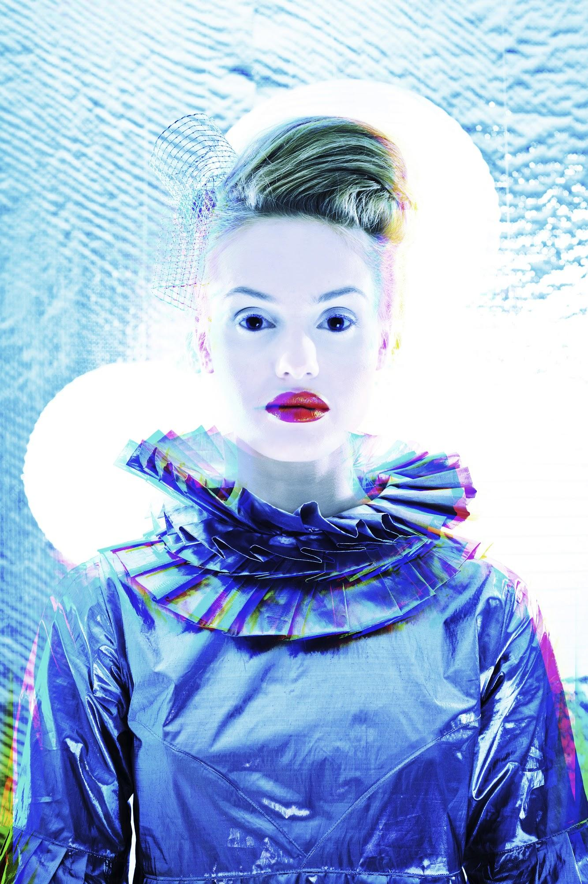

AngularJS 1.2
& Beyond

Slide 2
1.2 + Community
Matias Niemelä, Pete Bacon Darwin, brettcannon, Daniel Luz, Brian Ford, Shyam Seshadri, Lucas Galfasó, Braden Shepherdson, Fred Sauer, Brent Morrow, Jamie Krug, Luis Ramón López, Sudhir Jonathan, Chirayu Krishnappa, Jens Rantil, Alexander Shtuchkin, Jeremy Tymes, Dave Geddes, Siddique Hameed, petrovalex, Matias Niemelä, radu, Pawel Kozlowski, Luc Morin, James deBoer, Gonzalo Ruiz de Villa, Fredrik Bonander, Mark Nadig, Matt Ginzton, Arlen Christian Mart Cuss, Dean Sofer, Julie, David Bennett, Rado Kirov, Vineet Kumar, Per Rovegård, Christian Vuerings, Ben Ripkens, @fbiville, Robb Shecter, Keir Mierle, Robin Böhm, Colin Frei, Cedric Soulas, JP Sugarbroad, Eric Case, Laurent, Shai Reznik, Lee Leathers, Jamison Dance, Felipe Lahti, Thibault Leruitte, Jared Forsyth, Tim Macfarlane, Timothy Ahong, Martin Probst, Uri Goldshtein, Will Moore, Matt Haggard, Zach Snow, Zhenbo Zhang, Jay Zeng, Max Martinsson, danilsomsikov, Chris Dawson, Joakim Blomskøld, David Chang, metaweta, naomiblack, Oren Avissar, phil, quazzie, Amir H. Hajizamani, Jonathan Zacsh, Josh Adams, Paulo Ávila, Pedro Del Gallego, Keyamoon, Kris Jenkins, Kury Kruitbosch, Laurent Cozic, Luis Ramón López, Manuel Braun, Manuel Kiessling, Marcin Wosinek, Mark Chapman, Mark Dalgleish, Matt Hardy, Matt Rohrer, Matthew Browne, Matthew McComb, Matthieu Larcher, Maxim Grach, Merrick Christensen, Michal Reichert, Michał Gołębiowski, Misha Moroshko, Murilo da Silva, Niel de la Rouviere, Partap Davis, Pascal Borreli, Pascal Corpet, Patrick, Peter Evjan, Philip Roberts, PowerKiKi, Prathan Thananart, R. Merkert, Rishabh Rao, Robbie Ferrero, Romain Neutron, Ron Yang, Rosina Bignall, Ryan Schumacher, Sahat Yalkabov, Sam McCall, Samuel Santos, Seunghoon Yeon, Srinivas Kusunam, Stein Jakob Nordbø, Stephane Bisson, Steve Nicolai, Steven Davidson, Sujeet Pillai, Sylvester Keil, Thomas Schultz, Tom Davis, Tom Hughes, Trotter Cashion, Tyler Akins, Tyson Benson, Wes Alvaro, William Bagayoko, Xiangru Chen, Zach Dexter, _pants, adamshaylor, austingreco, brandonjp, csugden, deboer, es128, ggoodman, gockxml, jamesBrennan, johnlindquist, kamagatos, kim lokoy, leesei, nlaplante, pavelgj, sergiopantoja, sgtpep, sqwishy trick, theotheo, uberspeck, unirgy, urenmj, veselinn, willtj, winkler1, zeflasher, {Qingping,Dave} Hou, 玉黍, Adam Macejak, Adrian Gheorghe, Alan Klement, Alex Pods, Alex Young, Alfred Nutile, Anatoly Shikolay, Andreas Marek, Andreas Pelme, Andrew McLeod, Andrew Vida, Anna Vester, Anton, Artur Ostrega, Benjamín Eidelman, Brian Campbell, Brice Burgess, Bruno Coelho, Cameron Westland, Cezar Berea, Chad Smith, Chad Whitacre, Chris M, Chris Nicola, Christoph Burgdorf, Ciro Nunes, Colin Kahn, Dan Kohn, Daniel Demmel, Daniel Stockton, Daniel Tse, Dave Clayton, David Holmes, David Sanders, Dylan Pyle, Eddie Monge, Eduardo Garcia, Ehsan Ghandhari, Enrique Paredes, Eugene Wolfson, Ewen Cumming, Fernando Correia, Francesc Rosàs, Gergely Imreh, German Galvis, Gert Goet, Gias Kay Lee, Glenn Goodrich, Godmar Back, Gregory Pike, Hamish Macpherson, Haralan Dobrev, Heath Matlock, Illniyar, Iristyle, Iwein Fuld, James Morrin, Jamie Mason, Jamie R. Rytlewski, Jared Beck, Jason Als, Jason Morrison, Javier Mendiara Cañardo, Jeff Cross, Jeff Pickelman, Jeremy Wilken, Jesse Cooke, Jimmy Zhuo, Johannes Hansen, John Fletcher, John Hume, Jonathan Card, Juha Syrjälä, János Rusiczki, Jørgen Borgesen, Kai Groner, Kanwei Li, Kevin Old, Kevin Wells, Kevin Western, Kevin Old, Kevin Wells, Kevin Western

Slide 3
1.2 + Community
Matias Niemelä, Pete Bacon Darwin, brettcannon, Daniel Luz, Brian Ford, Shyam Seshadri, Lucas Galfasó, Braden Shepherdson, Fred Sauer, Brent Morrow, Jamie Krug, Luis Ramón López, Sudhir Jonathan, Chirayu Krishnappa, Jens Rantil, Alexander Shtuchkin, Jeremy Tymes, Dave Geddes, Siddique Hameed, petrovalex, Matias Niemelä, radu, Pawel Kozlowski, Luc Morin, James deBoer, Gonzalo Ruiz de Villa, Fredrik Bonander, Mark Nadig, Matt Ginzton, Arlen Christian Mart Cuss, Dean Sofer, Julie, David Bennett, Rado Kirov, Vineet Kumar, Per Rovegård, Christian Vuerings, Ben Ripkens, @fbiville, Robb Shecter, Keir Mierle, Robin Böhm, Colin Frei, Cedric Soulas, JP Sugarbroad, Eric Case, Laurent, Shai Reznik, Lee Leathers, Jamison Dance, Felipe Lahti, Thibault Leruitte, Jared Forsyth, Tim Macfarlane, Timothy Ahong, Martin Probst, Uri Goldshtein, Will Moore, Matt Haggard, Zach Snow, Zhenbo Zhang, Jay Zeng, Max Martinsson, danilsomsikov, Chris Dawson, Joakim Blomskøld, David Chang, metaweta, naomiblack, Oren Avissar, phil, quazzie, Amir H. Hajizamani, Jonathan Zacsh, Josh Adams, Paulo Ávila, Pedro Del Gallego, Keyamoon, Kris Jenkins, Kury Kruitbosch, Laurent Cozic, Luis Ramón López, Manuel Braun, Manuel Kiessling, Marcin Wosinek, Mark Chapman, Mark Dalgleish, Matt Hardy, Matt Rohrer, Matthew Browne, Matthew McComb, Matthieu Larcher, Maxim Grach, Merrick Christensen, Michal Reichert, Michał Gołębiowski, Misha Moroshko, Murilo da Silva, Niel de la Rouviere, Partap Davis, Pascal Borreli, Pascal Corpet, Patrick, Peter Evjan, Philip Roberts, PowerKiKi, Prathan Thananart, R. Merkert, Rishabh Rao, Robbie Ferrero, Romain Neutron, Ron Yang, Rosina Bignall, Ryan Schumacher, Sahat Yalkabov, Sam McCall, Samuel Santos, Seunghoon Yeon, Srinivas Kusunam, Stein Jakob Nordbø, Stephane Bisson, Steve Nicolai, Steven Davidson, Sujeet Pillai, Sylvester Keil, Thomas Schultz, Tom Davis, Tom Hughes, Trotter Cashion, Tyler Akins, Tyson Benson, Wes Alvaro, William Bagayoko, Xiangru Chen, Zach Dexter, _pants, adamshaylor, austingreco, brandonjp, csugden, deboer, es128, ggoodman, gockxml, jamesBrennan, johnlindquist, kamagatos, kim lokoy, leesei, nlaplante, pavelgj, sergiopantoja, sgtpep, sqwishy trick, theotheo, uberspeck, unirgy, urenmj, veselinn, willtj, winkler1, zeflasher, {Qingping,Dave} Hou, 玉黍, Adam Macejak, Adrian Gheorghe, Alan Klement, Alex Pods, Alex Young, Alfred Nutile, Anatoly Shikolay, Andreas Marek, Andreas Pelme, Andrew McLeod, Andrew Vida, Anna Vester, Anton, Artur Ostrega, Benjamín Eidelman, Brian Campbell, Brice Burgess, Bruno Coelho, Cameron Westland, Cezar Berea, Chad Smith, Chad Whitacre, Chris M, Chris Nicola, Christoph Burgdorf, Ciro Nunes, Colin Kahn, Dan Kohn, Daniel Demmel, Daniel Stockton, Daniel Tse, Dave Clayton, David Holmes, David Sanders, Dylan Pyle, Eddie Monge, Eduardo Garcia, Ehsan Ghandhari, Enrique Paredes, Eugene Wolfson, Ewen Cumming, Fernando Correia, Francesc Rosàs, Gergely Imreh, German Galvis, Gert Goet, Gias Kay Lee, Glenn Goodrich, Godmar Back, Gregory Pike, Hamish Macpherson, Haralan Dobrev, Heath Matlock, Illniyar, Iristyle, Iwein Fuld, James Morrin, Jamie Mason, Jamie R. Rytlewski, Jared Beck, Jason Als, Jason Morrison, Javier Mendiara Cañardo, Jeff Cross, Jeff Pickelman, Jeremy Wilken, Jesse Cooke, Jimmy Zhuo, Johannes Hansen, John Fletcher, John Hume, Jonathan Card, Juha Syrjälä, János Rusiczki, Jørgen Borgesen, Kai Groner, Kanwei Li, Kevin Old, Kevin Wells, Kevin Western, Kevin Old, Kevin Wells, Kevin Western
Thank you!

Slide 4
ng-animate
Declaratively add animations to your App
Supports CSS animations & transitions (/w JS fallback)
CSS controls animation life-cycle
Orchestrates DOM changes (add / move / remove)
Keeps track of timing & applies classes
Gracefully degrade on old browsers (JS fallback)
Prevents nested animations
DEMO

Slide 5
ng-animate vNext
Declaratively add CSS class transitions
Today: animate structural DOM changes
vNext: animate structural + class changes

Slide 6
$http
Support for Blobs (custom responseTypes)
Support for authentication (withCredentials)
Customizable XSRF header and cookie names
Aborting requests
Around interceptors

Slide 7
$http (around interceptors)
Intercept requests and responses in your application via promise based api.
Great for:
authentication
async request/response transforms
transparent error recovery
Docs: $httpProvider.interceptors

Slide 8
$resource
more configuration options (headers, urls, ...)
resource interceptors
api enhanced with promises
DEMO

Slide 9
$route & ngView
separate module
catch all params matching
when('/users/:userId/params/*params/edit'
animation support
DEMO

Slide 10
ngRepeat (animations)
<tr ng-repeat="project in list.projects"
ng-animate=" 'slide' ">
<td>{{project.name}}</td>
<td>{{project.description}}</td>
</tr>
DEMO

Slide 11
ngRepeat (multi-element repeater)
Repeat over multiple elements
<dt ng-repeat-start="book in books">
{{book.title}}
</dt>
<dd>{{book.author}}</dd>
<dd ng-repeat-end>
{{book.description}}
</dd>
DEMO

Slide 12
ngRepeat (track by)
Control association between model and DOM:
<tr ng-repeat="student in students
track by student.id">
<td>{{student.name}}</td>
<td>{{student.score}}</td>
</tr>
DEMO

Slide 13
Controller as
<body
ng-controller="DemoController as demo">
<tr ng-repeat="student in demo.students">
<td>{{student.name}}</td>
</tr>
</body>
function DemoController() {
this.students = [...]
}
DEMO

Slide 14
ng-if
Conditionally compile template fragment:
<clock ng-if="demo.stopWatchEnabled">
</clock>
DEMO

Slide 15
Expression language
Support for new operators: ===, !== and ?
<p ng-if="loggedIn === 'true'">
<a href="/logout">Log out</a>
</p>
ng-class="loggedIn ? 'user':'anonym'"

Slide 16
Touch / Mobile support
ngMobile (ngTouch) module
<button ng-click="doStuff()">tap here</button>
<article ng-swipe="expand()">
...
</article>
DEMO

Slide 17
Security stuff
CSP autodetection
Automatic Contextual Escaping for images and links
More security hardening (binding to iframes, scripts, etc)

Slide 18
Better Error Messages
Before:
Uncaught Error: No module: ngResource
After:
Uncaught Error: [di-nomod] Module 'ngResource' is not available! You either misspelled the module name or forgot to load it.
http://docs.angularjs.org/errors/di-nomod?a=ngResource
In production:
Uncaught Error: [di-nomod] http://docs.angularjs.org/errors/di-nomod?a=ngResource

Slide 19
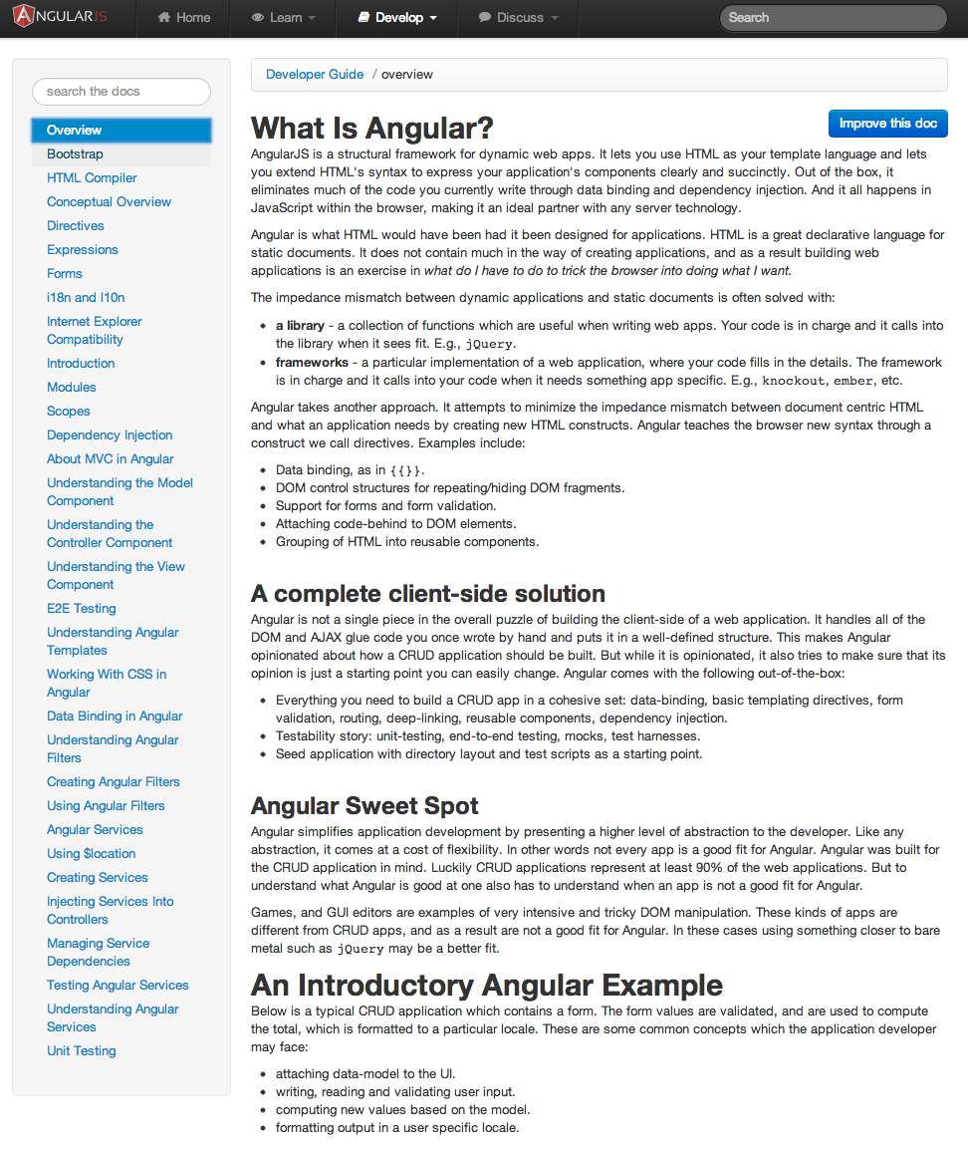
*&$%@ Docs!

Slide 20
Documentation Improvements
Navigation, Search, API organization
Interactive Tutorial
Best Practices
Directives
Testing
Scope, digest, apply, $compile, transclude
Modules / ID

Slide 21
And beyond...

Slide 22





Notes:
Today, folks use Angular primarily with JavaScript.
But we've also seen much enthusiasm for using it with other languages that compile to JavaScript like CoffeeScript, TypeScript, and ClojureScript.

Slide 23
Angular on Dart
Port of AngularJS, optimized for Dart
Same templates, separate implementation
Current status:
Core: $compiler, $scope, expressions
Basic directives: ngBind, ngRepeat
Critical bits: DI, Routes
Testing: Karma
Open source at: https://github.com/angular/angular.dart

Slide 24
Angular Next - based new standards
Object.observe()
DOM Mutation Observers (DMO)
<template> element
Shadow DOM
Web Components
Model Drive Views (MDV)
Forward polyfills and transpilers for legacy browsers.

Slide 25
Angular Next - Break up the core
Power to the People
angular.js
$location
$http
angular-resource.js
angular-route.js
angular-sanitize.js
...
$parse
$compile
dateFilter
ngRepeat
$injector
etc...

Slide 26
End-to-end Testing with Protractor
The successor to Angular Scenario Runner.
https://github.com/juliemr/protractor
same great integration with Angular
based on top of WebDriver
full control over browser

Slide 27
Thanks!
http://goo.gl/bl9Lw

